Slide 1


SEE 4 ME
Object Detection Aid for Visually Impaired
Presented By:
Safee Ullah Mughal
Laila Ikram
Mahnoor Fiaz
Mohammad Noman
Zohaib Shahzad

Slide 2
Background
Need: Visually impaired individuals rely on non-visual cues to interact with surroundings.
Current Limitations: White canes & guide dogs have range and cost limitations.
IoT Benefit: Real-time processing, portability, low-cost and scalable solution.
Purpose: Help visually impaired individuals detect and recognize nearby objects with estimated distance.
Core Tech: ESP32-CAM, OpenCV, TTS, Java, IoT principles.
Key Feature: Detected objects and estimated distance and convert it into speech in real-time.
See 4 Me

Slide 3
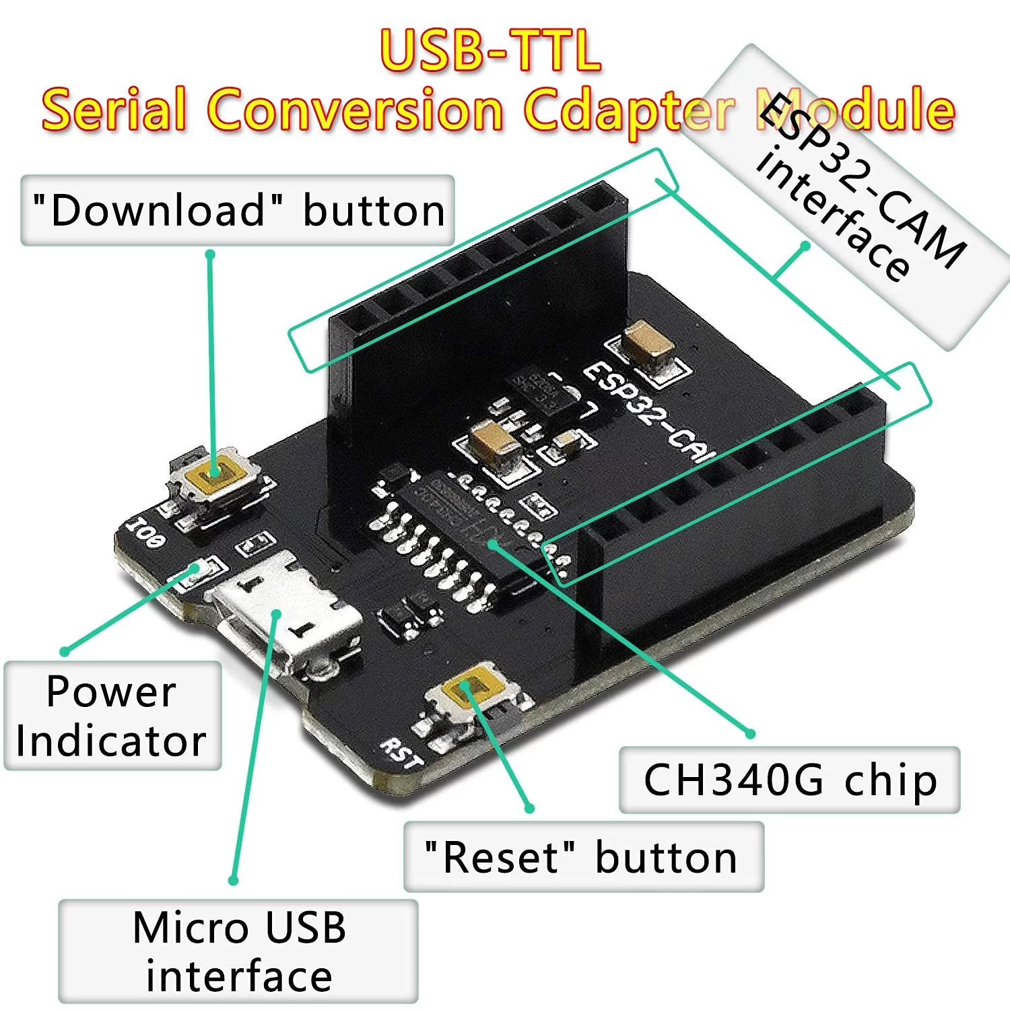
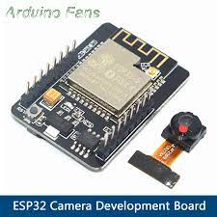
Equipment Used
Softwares Used
ESP 32 Cam module (OV2640 cam)
ESP 32 MB Board
Powerbank 5000 mAh
Android mobile
Handsfree/Headphones (optional)
Feature | ESP 32 Cam | ESP-32 MB
Communication | WiFi, BT & BLE | UART
RAM | 520 kb SRAM 4MB PSRAM | No onboard RAM
Flash | 4 MB Flash | Relies on ESP32 CAM
Power Consumption | Active @ 5V ~ 310 mA Deep Sleep 5 mA | 5V ~ 200 mA
Specificity (img) | Jpeg, BMP & Grayscale | N/A
Arduino IDE
Android Studio

Slide 4
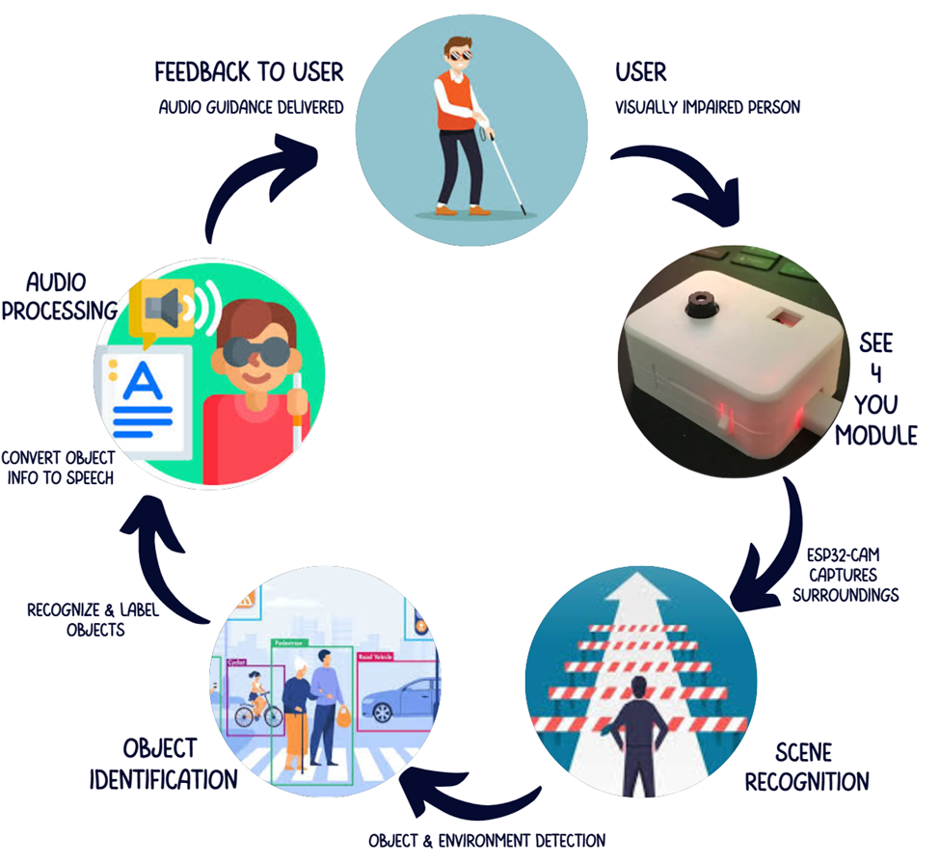
Methodology
Workflow:
ESP32-CAM captures and compresses the image.
Image is transferred to the mobile app using Wi-Fi (WebSocket).
The app performs object recognition and identification.
Distance is estimated based on object size or placement.
Identified object is converted to speech using TTS.
Audio guidance is delivered via speaker or earphones.
This cycle runs continuously for real-time assistance.

Slide 5
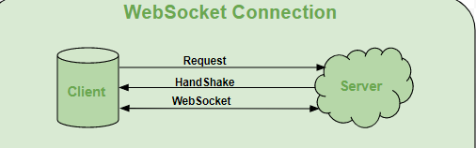
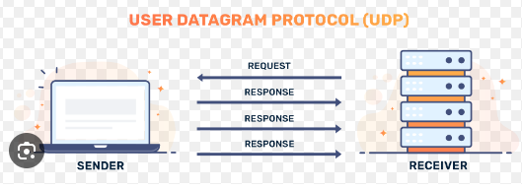
IoT Communication & Protocols
Communication:
WiFI (2.4 GHz)
Wireless communication between ESP32-CAM and the mobile app via Wi-Fi within a local network.
Protocol used:
Websocket(TCP):
For reliable image transmission with low overhead and persistent connection.
UDP:
Lightweight protocol used for lightweight control messages like LED status and signals. There is no requirement of reliability.

Slide 6
Mobile Application
Purpose of the App
Receives compressed image data (binary) from ESP32-CAM
Detects objects using OpenCV
Provides real-time voice feedback via Text-to-Speech (TTS)
Helps visually impaired users understand surroundings through sound
Technologies Used
Language: Java
IDE: Android Studio
Libraries:
OpenCV for detection
Android TTS for speech
WebSocket Client for video stream
Dependencies
OpenCV Android wrapper (from GitHub)
WebSocket Java library (from GitHub)
Integrated via Gradle and manual imports
Main Features
Object Detection: Identifies items like people, chairs, and doors
Distance Estimation: Announces how far the object is (e.g., “2 meters ahead”)
Audio Output: Speaks object name via speaker or Bluetooth
Offline Use: No internet needed after connecting to ESP32-CAM
Simple Workflow
Connects to ESP32-CAM over Wi-Fi
Receives and decodes image stream
Detects & labels objects using OpenCV
Converts label to speech and plays it
Delivers real-time audio feedback to the user

Slide 7
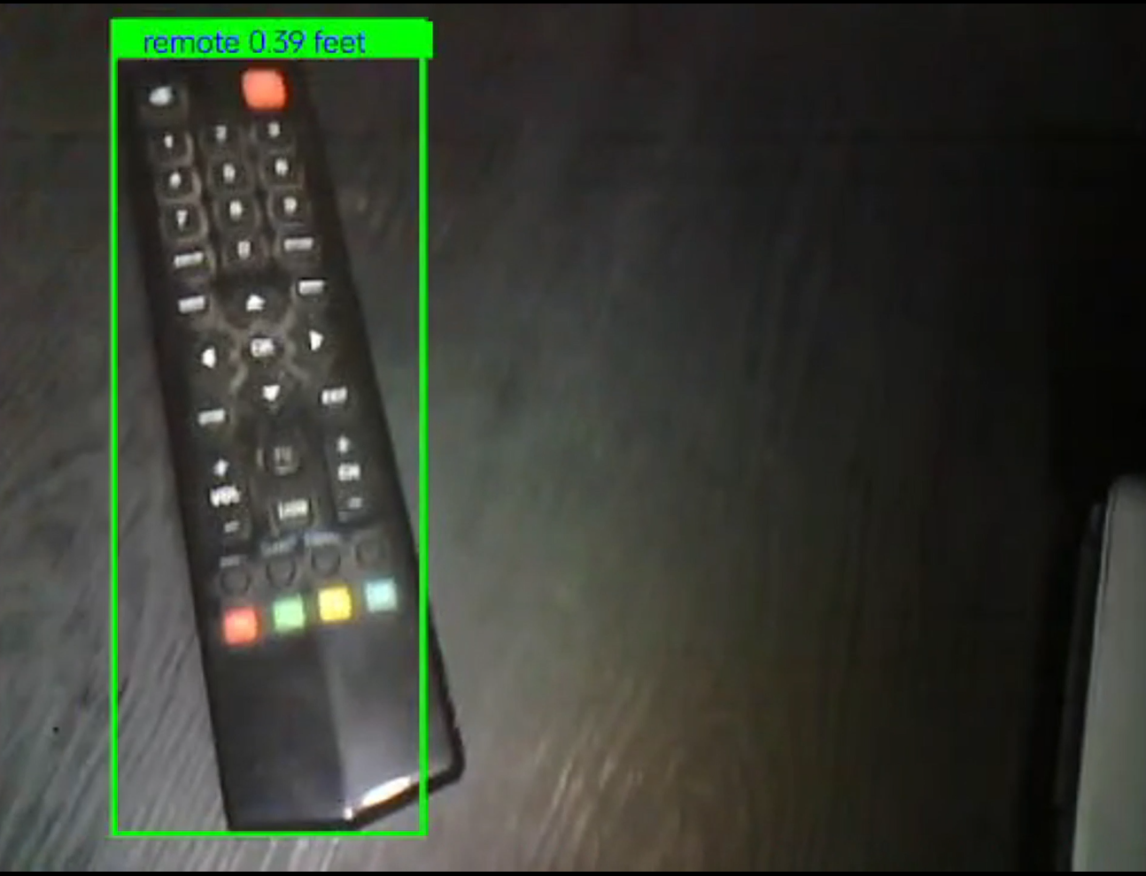
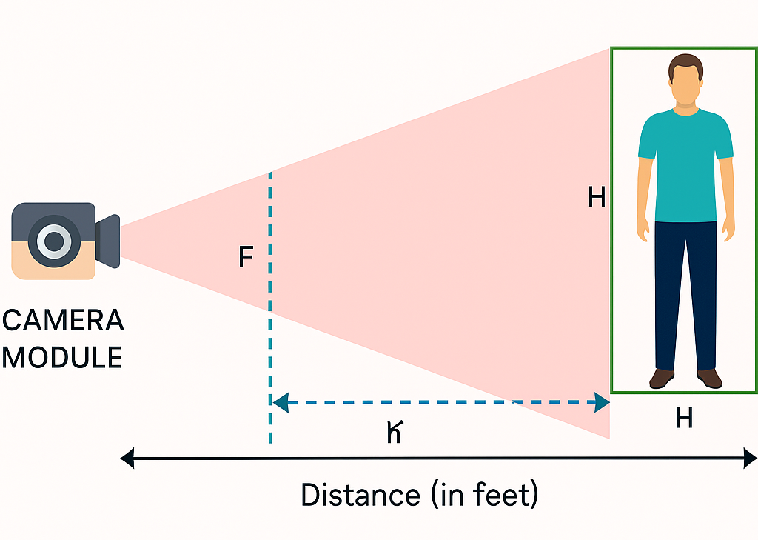
Object Detection & Distance Estimation
High resolution of 1600x1200 (2MP), ensuring detailed detection and clear object recognition
Delivers 24 frames per second (fps), ensuring smooth, real-time processing for dynamic environments.
Model used MobileNet SSD which can detect upto 20 classes of objects.
Distance is calculated in feet w.r.t to the size and placement of objects in frame using pinhole camera model (max 18 feet)
Detected object's name and estimated distance (labelled) is sent to Text-to-Speech engine.

Slide 8
Text-to-Speech (TTS) Module
Enabling Auditory Feedback for the Visually Impaired

Slide 9
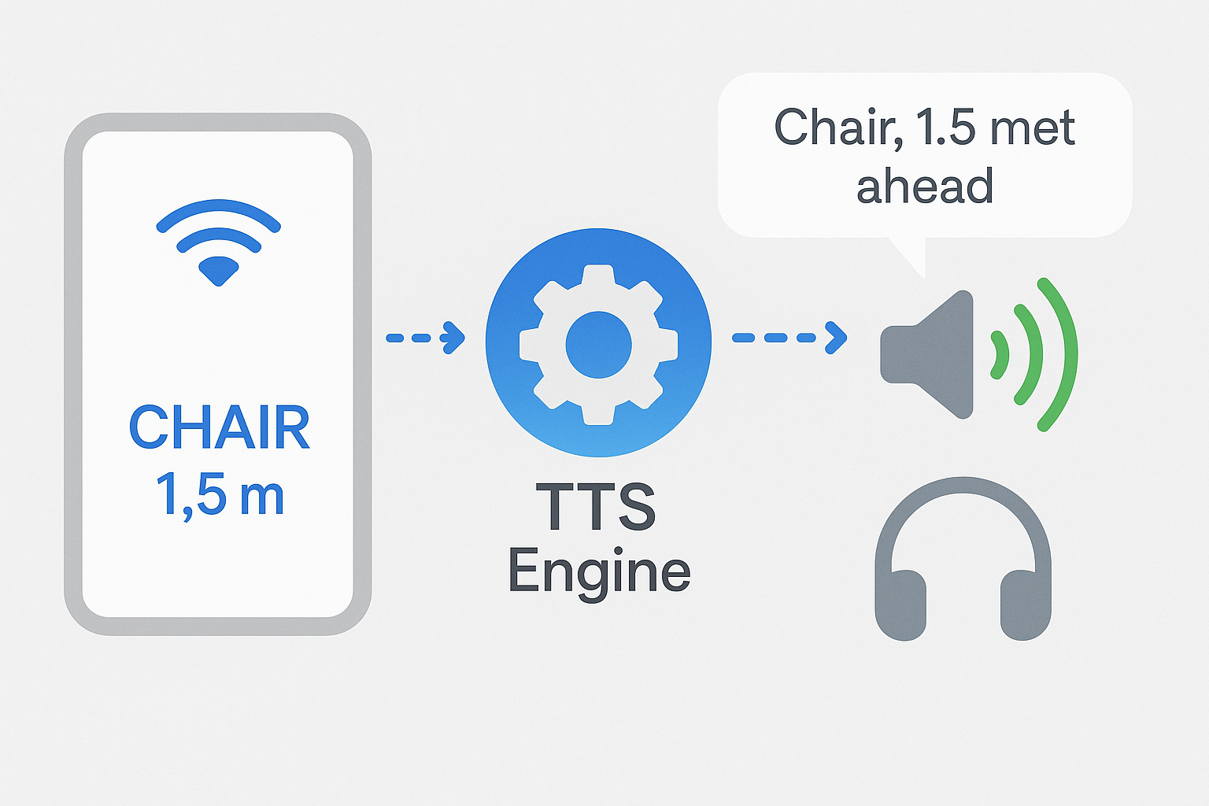
Agenda
Visual Representation
Introduction to TTS
Role in "See For Me"
How TTS Works in the System
Key Features & Advantages
Why TTS Over Other Feedback Methods?
Future Enhancements

Slide 10
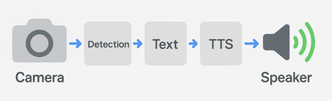
What is Text-to-Speech (TTS)?
How It Fits in the System:
Role of TTS in "See For Me"
Converts written text into natural-sounding speech.
Used in assistive tech, navigation, and smart devices.
ESP32-CAM captures image → Mobile App detects object.
OpenCV generates label → TTS converts to speech.
Audio feedback via phone / headphones.
Visually impaired users cannot see detected objects.
TTS bridges the gap by vocalizing: Object names & Distance

Slide 11
How TTS Works in the System
Technical Components:
Key Features of the TTS Module:
Input:
Object label + distance from OpenCV (e.g., "Table, 3 feet").
Speech Synthesis:
Neural networks generate human-like voice.
Output:
Audio played through mobile device.
Offline TTS Engine
(e.g., Android’s built-in TTS).
Latency:
<500ms for real-time feedback.
Real-Time Conversion:
Natural Voice:
Offline Functionality:
Customizable Alerts:

Slide 12

Future Enhancements
Multilingual Support
Voice Customization
Contextual Feedback
Emotion-Based Tones

Slide 13
Challenges
Limitations
Future Work
Limited RAM and processing power of microcontroller.
Power Management.
Data Transmission Latency.
Network Dependency.
Latency
Distance measurement
Accuracy of object detection
Edge Computing Integration
Global IoT Connectivity
LIDAR can be used to detect obstacle in surroundings
Standalone Operation
Custom Power Module Design

Slide 14
Conclusion
Developed a wearable, real-time visual assistance system using ESP32-CAM.
Enabled object detection, distance estimation, and voice feedback.
Designed for low-cost, low-power, and offline operation to increase accessibility.
Improved independence and situational awareness for visually impaired users.
Custom hardware and mobile app integration enhanced usability.
Future work includes standalone edge processing and better power optimization.

Slide 15
Video Demonstration
https://github.com/Safee-Ullah-Mughal/See-For-Me
© Base Android application ESP32-CAM Ai was developed by Hackster.io for robot. We modified to include object detection and text-to-speech (TTS) functionality.

Slide 16
THANKYOU
Project Link: https://github.com/Safee-Ullah-Mughal/See-For-Me

